Slide 1

Interactive platform between teachers and students
—systems analysis and design
BY :Jitong Zhao
Our Team: Liu Qingqing
Zhao Jitong
Yu Jun
Li chenxi
Ren Juhui

Slide 2

catalogue
Functional requirements
Non-functional requirements
Architecture design
Database design
Preliminary design

Slide 3
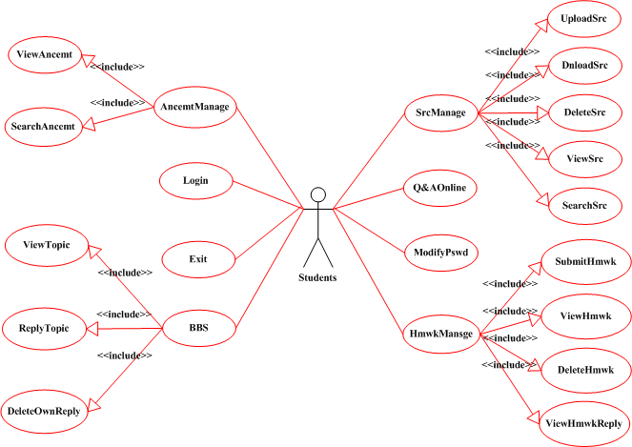
Functional requirements
students
Use case
1
1

Slide 4
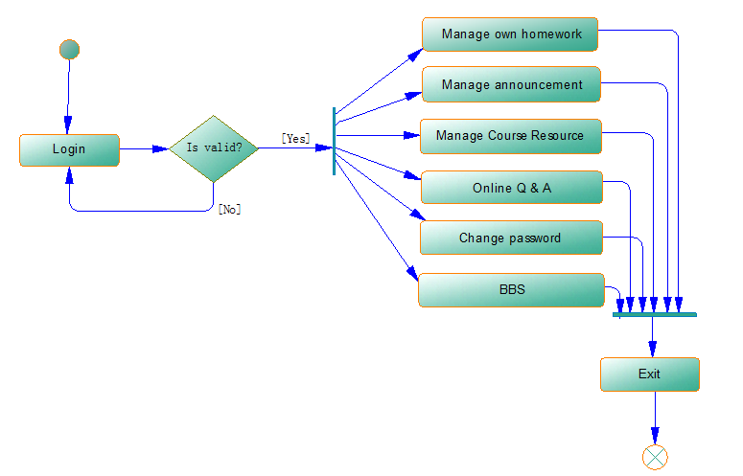
Functional requirements
students
activity diagram
2
1

Slide 5
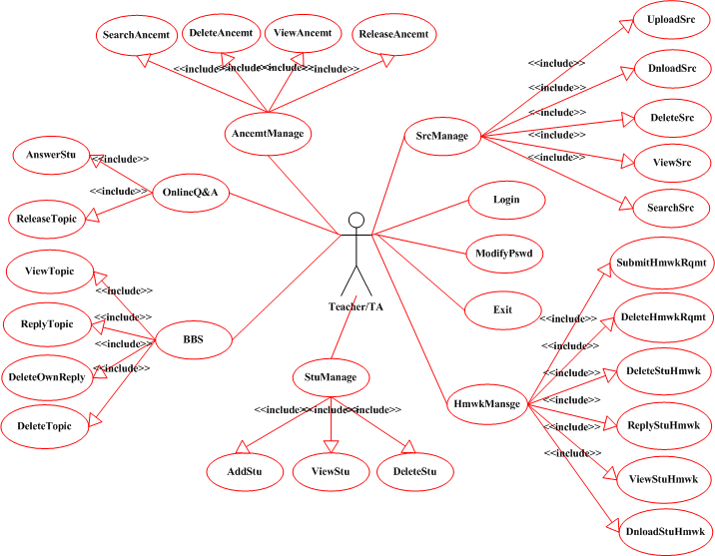
Functional requirements
teachers
& TAs
Use case
3
1

Slide 6
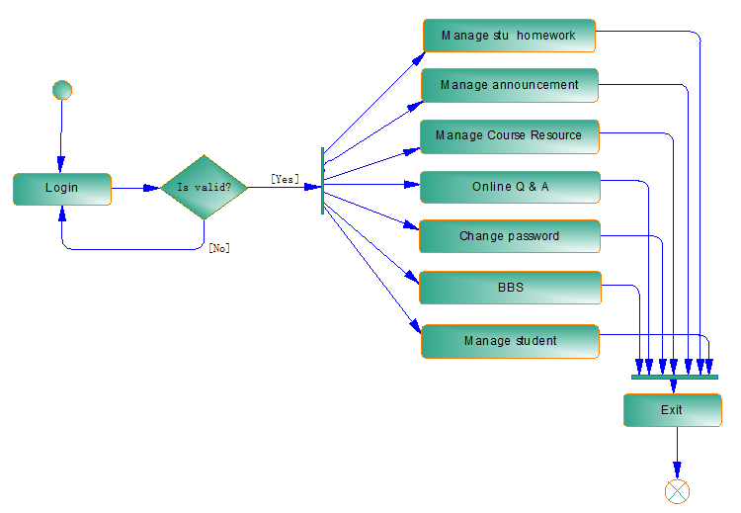
Functional requirements
teachers
& TAs
Activity diagram
4
1

Slide 7
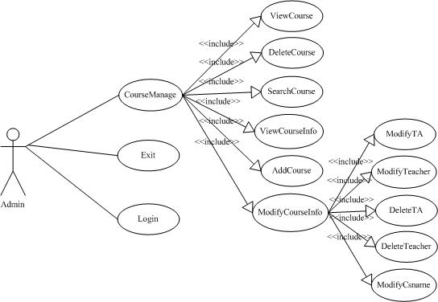
Functional requirements
administr-ator
Use case
5
1

Slide 8
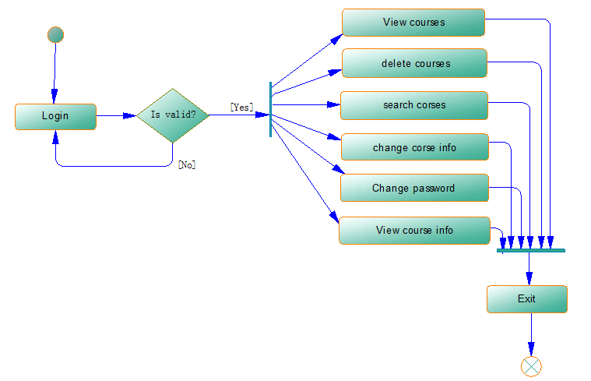
Functional requirements
administr-ator
Activity diagram
6
1

Slide 9
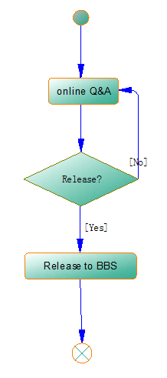
Functional requirements
——release the Q&A content
Activity diagram
7

Slide 10
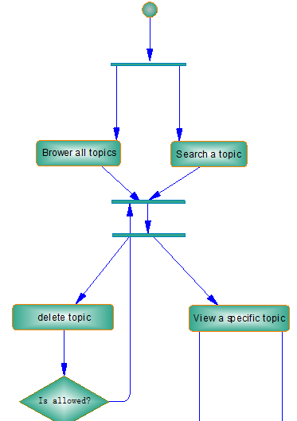
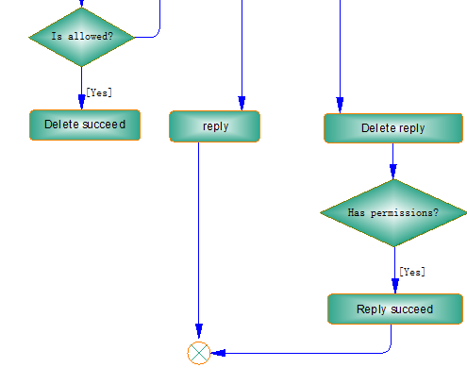
Functional requirements
——BBS
Activity diagram
8

Slide 11
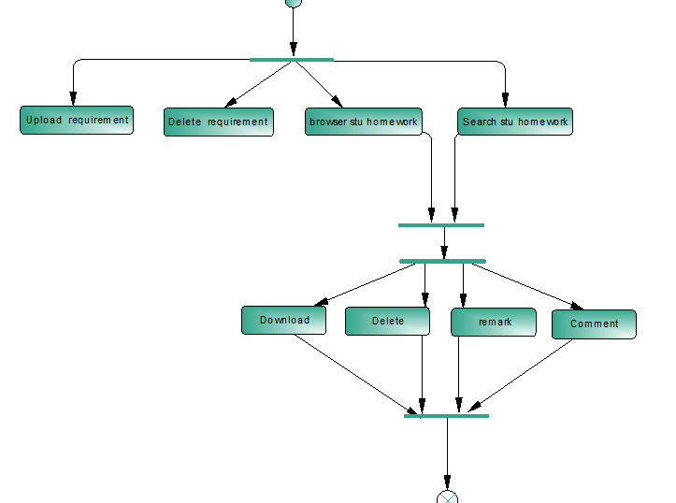
Functional requirements
——Student homework management
Activity diagram
9

Slide 12
Non-functional requirements
Performance
Response time: <20s
Security
e.g. Password Encryption
Safety
Verification code
File type & size
.doc(x) .pdf .ppt(x) .zip
.jpg .png . bmp .gif
size<500M
students
Use case
1
1

Slide 13
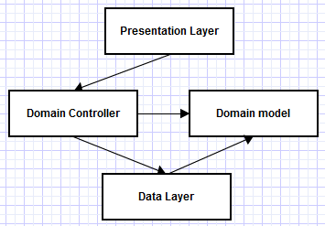
Architecture design
Presents the system content,
interact with the user,
and get the user request
Each operation
corresponds to
a controller
such as
some entity classes
Domain layer:
Processing business logic,
get results, and returns it to
the presentation layer to display
Interact with the database,
owe all of the data operations
of domain layer requires

Slide 14
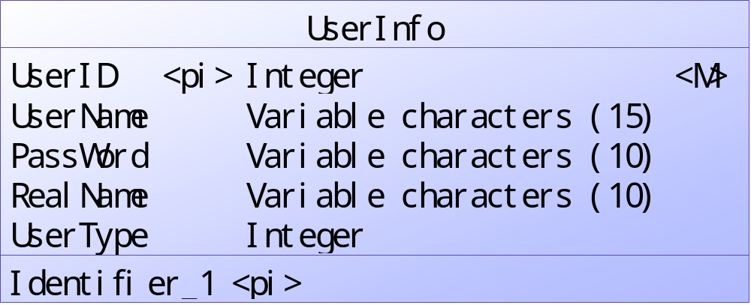
Database design
E-R diagram
1
UserType:1 on behalf of student
2 on behalf of TAs
3 on behalf of teachers
4 on behalf of admin

Slide 15
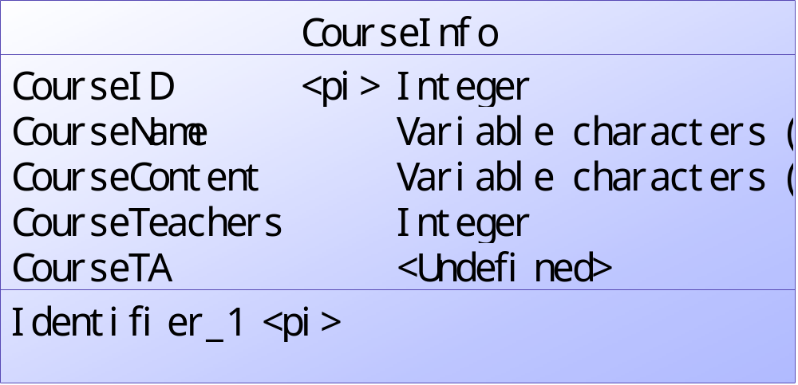
Database design
E-R diagram
2

Slide 16
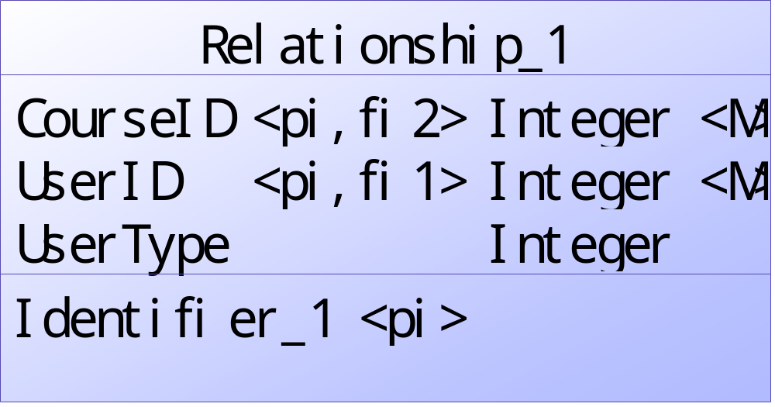
Database design
E-R diagram
3

Slide 17
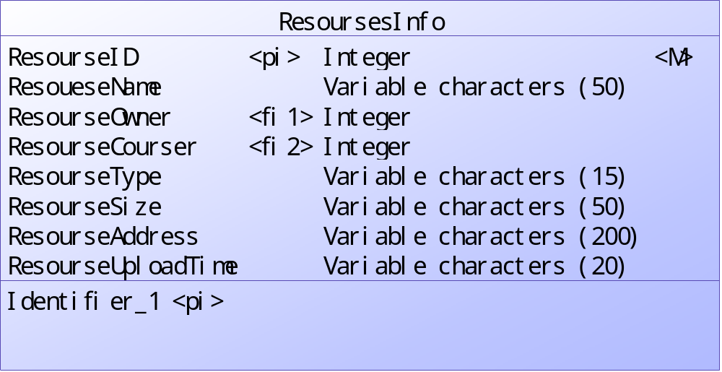
Database design
E-R diagram
4
ResourseOwner connect to UserInfo table
ResourseCourser connect to CourseInfo table

Slide 18
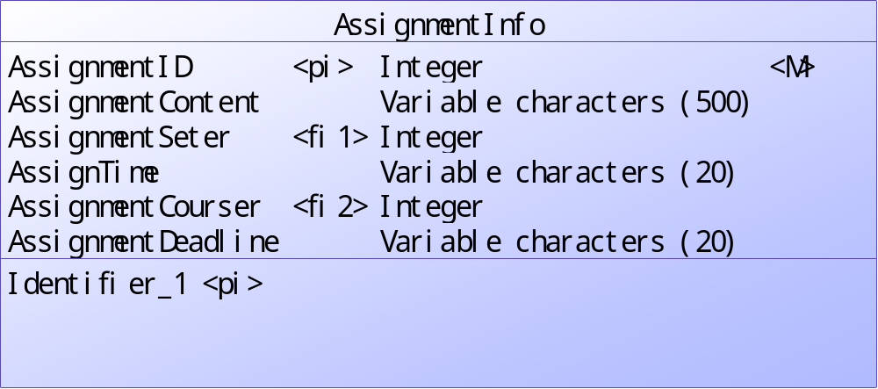
Database design
E-R diagram
5
AssignmentSeter connect to UserInfo table
AssignmentCourser connect to CourseInfo table

Slide 19
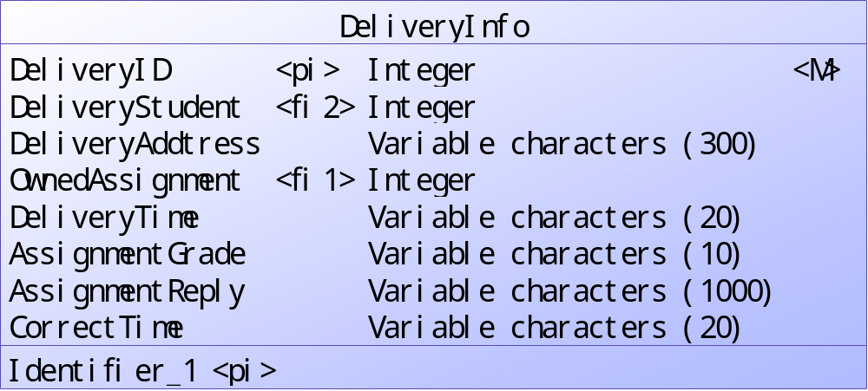
Database design
E-R diagram
6
OwnedAssignment connect to AssignmentInfo table
DeliveryStudent connect to UserInfo table

Slide 20
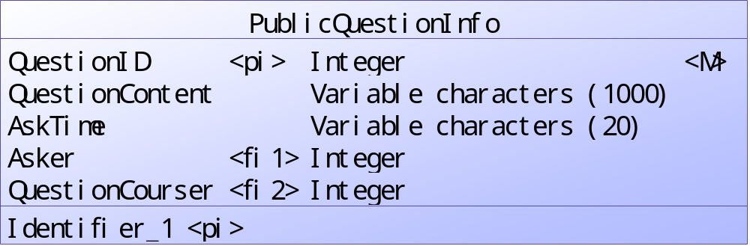
Database design
E-R diagram
7
Asker connect to UserInfo table
QuestionCourser connect to CourseInfo table

Slide 21
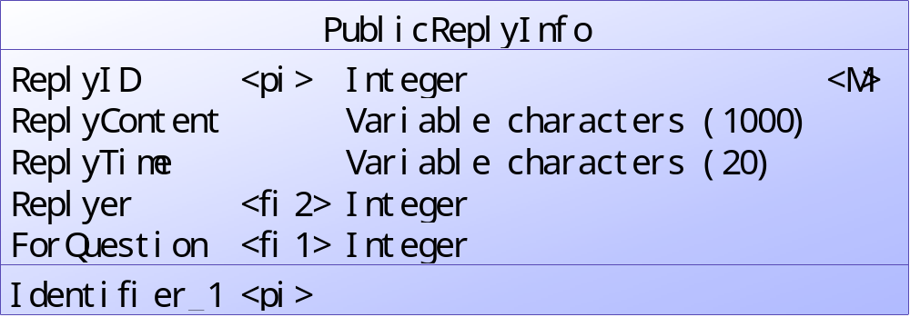
Database design
E-R diagram
8
ForQuestion connect to PublicQuestionInfo table
Replyer connect to UserInfo table

Slide 22
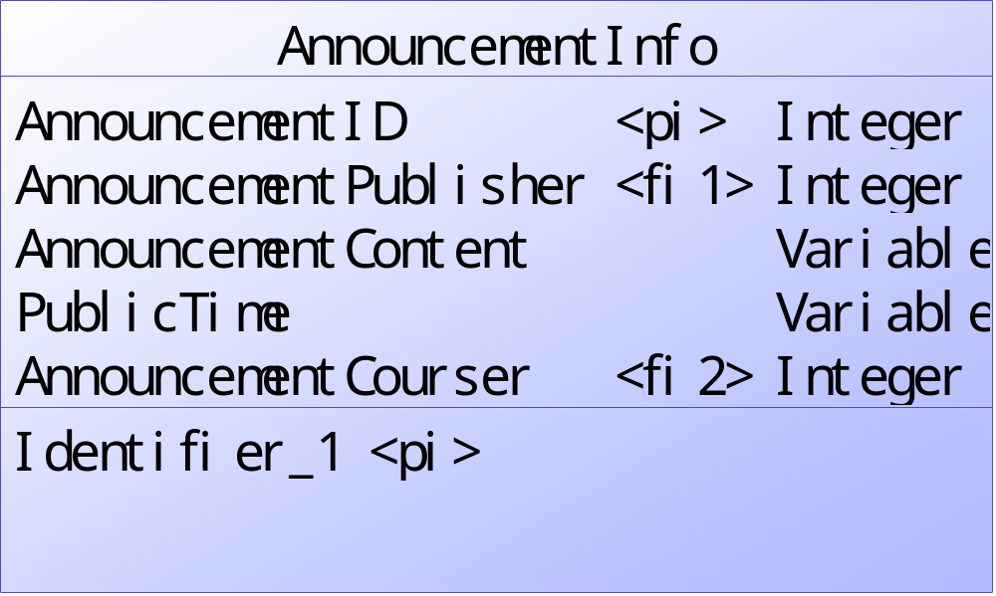
Database design
E-R diagram
9
AnnouncementCourser connect to CourseInfo table
AnnouncementPublisher connect to UserInfo table

Slide 23
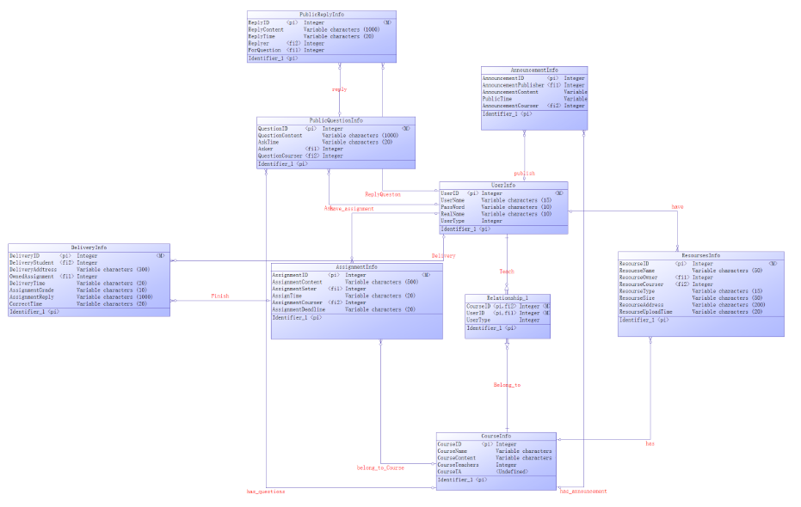
Database design
E-R diagram
10

Slide 24
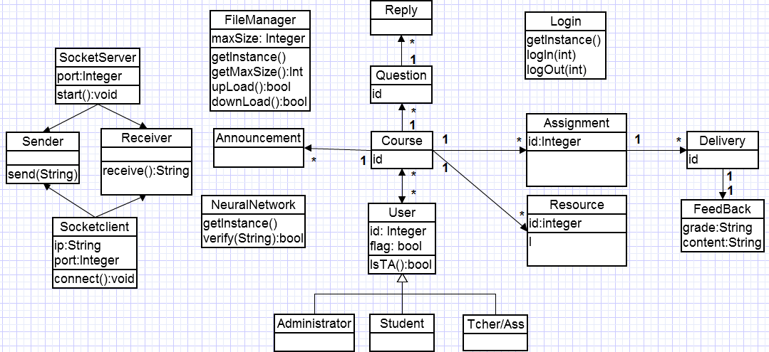
preliminary design
Domain Model
Class diagram
1

Slide 25
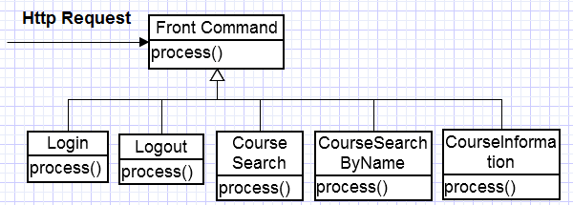
preliminary design
Index:
Domain Controller
Class diagram
2

Slide 26
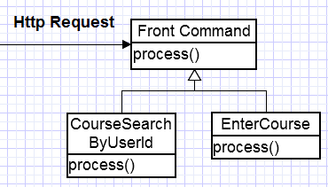
preliminary design
Home Page:
Domain Controller
Class diagram
3

Slide 27
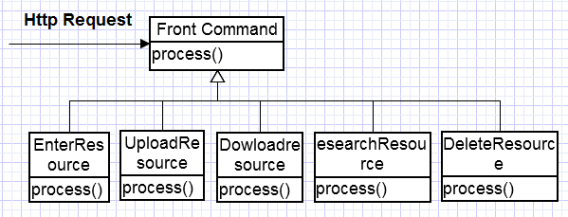
preliminary design
Courses resourse page:
Domain Controller
Class diagram
4

Slide 28
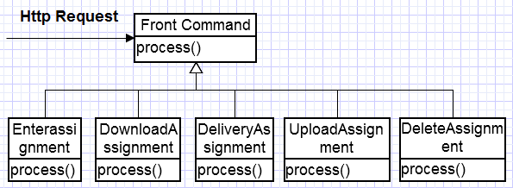
preliminary design
Homework Page:
Domain Controller
Class diagram
5

Slide 29
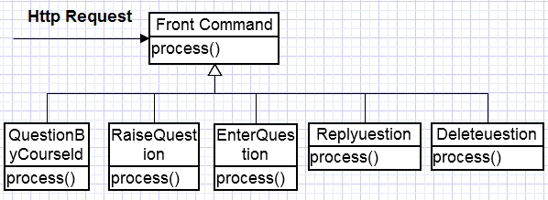
preliminary design
Q&A page:
Domain Controller
Class diagram
6

Slide 30
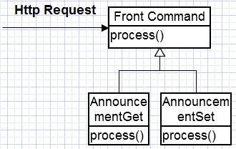
preliminary design
Announcement page:
Domain Controller
Class diagram
7

Slide 31
Thank You!

